Slide 1
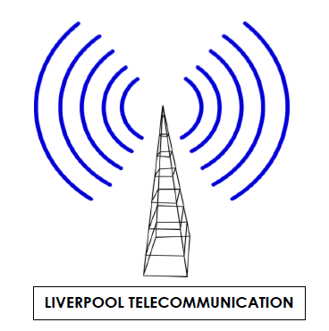
Retaining Customers in the Digital Age: A Predictive Model for Customer Loyalty
By : Rizki Pria Aditama

Slide 2
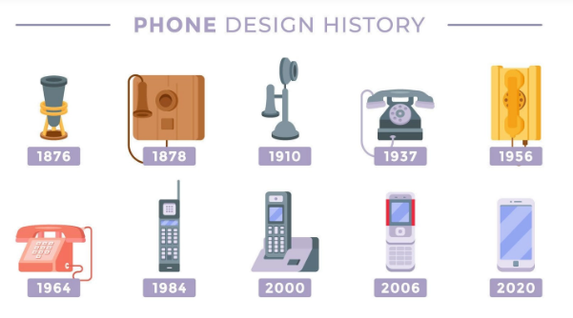
LIVERPOOL TELECOMMUNICATION (ltc) AT A GLANCE
"We existed before you were born."
Founded in 1892, Liverpool Telecommunications is one of the oldest and most trusted telecommunications companies in the industry. With over 130 years of experience, we have been at the forefront of technological innovation, continually evolving to meet the ever-changing needs of our customers.

Slide 3


INTRODUCTION
Background
The importance of customer loyalty impacts almost every metric important to running a business. Without happy customers who continue to buy from you, the business won't survive.
The rapid development of the telecommunications industry.
Objective
Deep dive on Customer Churn Dataset.
Modelling solution for identified non-loyal customer.

Slide 4

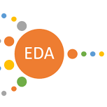



DATASET
exploratory data analysis
feature engineering
MODELING
INSIGHTS
WORKFLOW

Slide 5
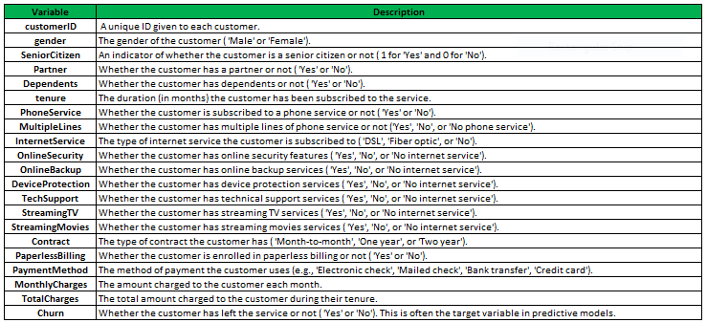
DATASET OVERVIEW
SOURCE
SHAPE
DATA TYpes
Customer Churn - Decision Tree & Random Forest | Kaggle
21 Columns
7043 Rows
String (12)
Boolean (5)
Decimal (2)
Other (2)
Data dictionary

Slide 6
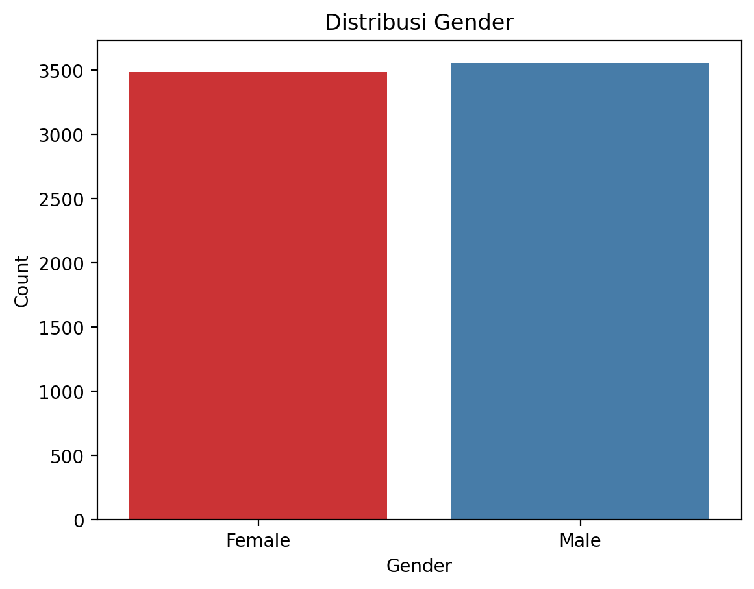

Exploratory Data Analysis
Gender distribution

Slide 7
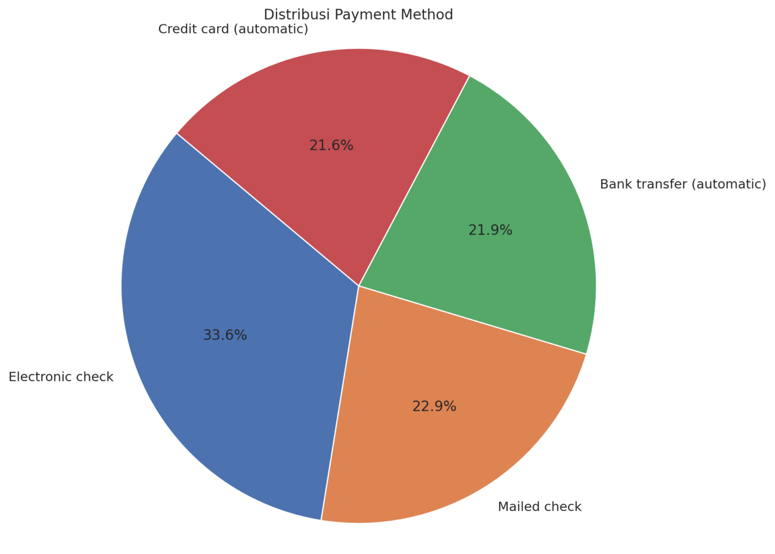
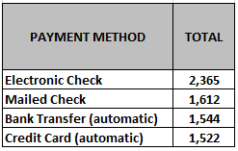
Exploratory Data Analysis
PAYMENT METHOD

Slide 8
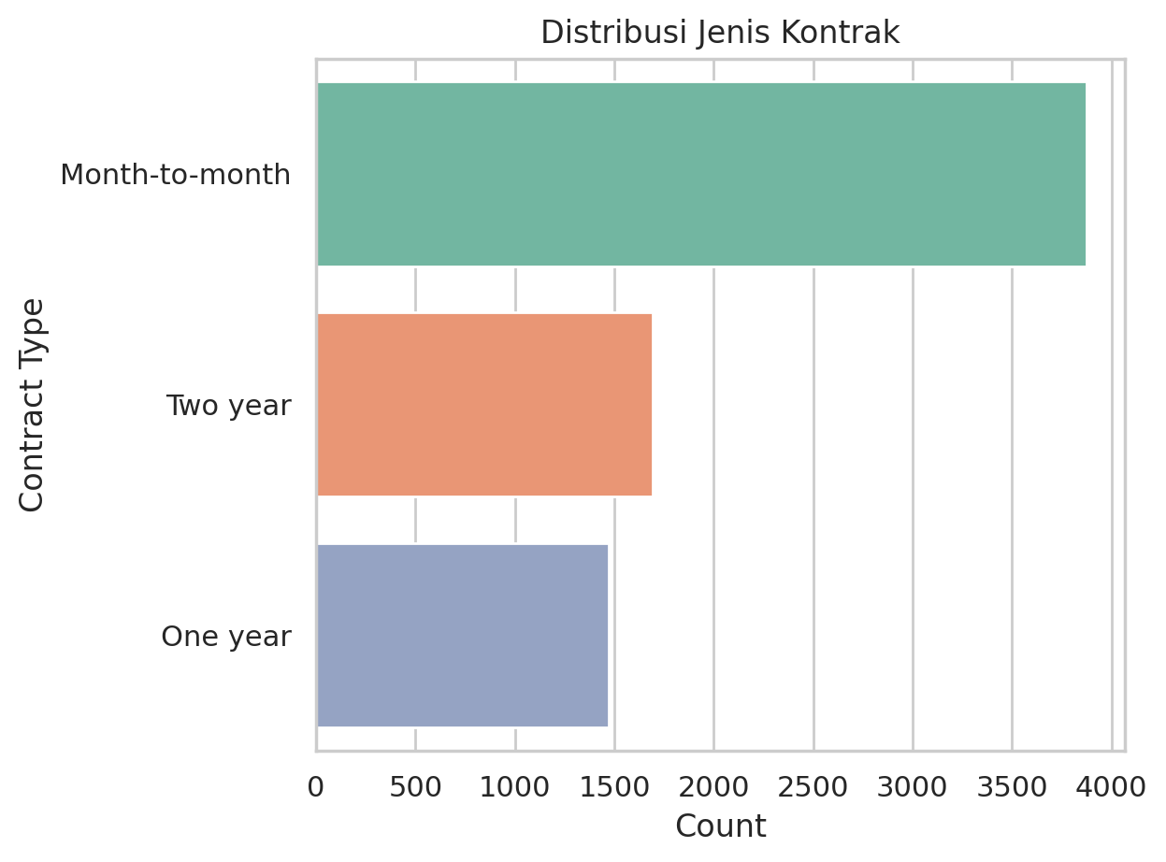
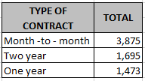
Exploratory Data Analysis
TYPE OF CONTRACT DISTRIBUTION

Slide 9
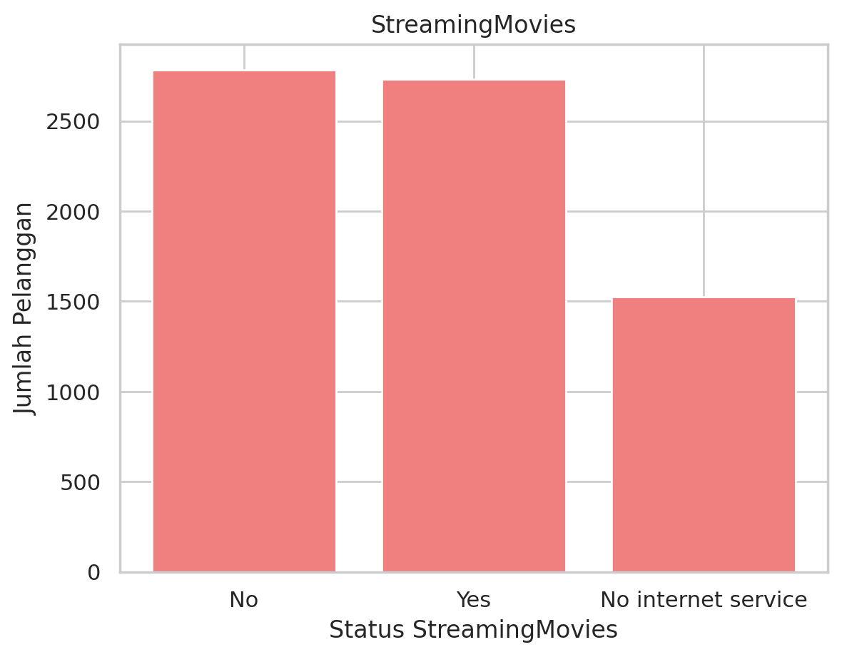

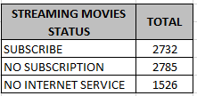
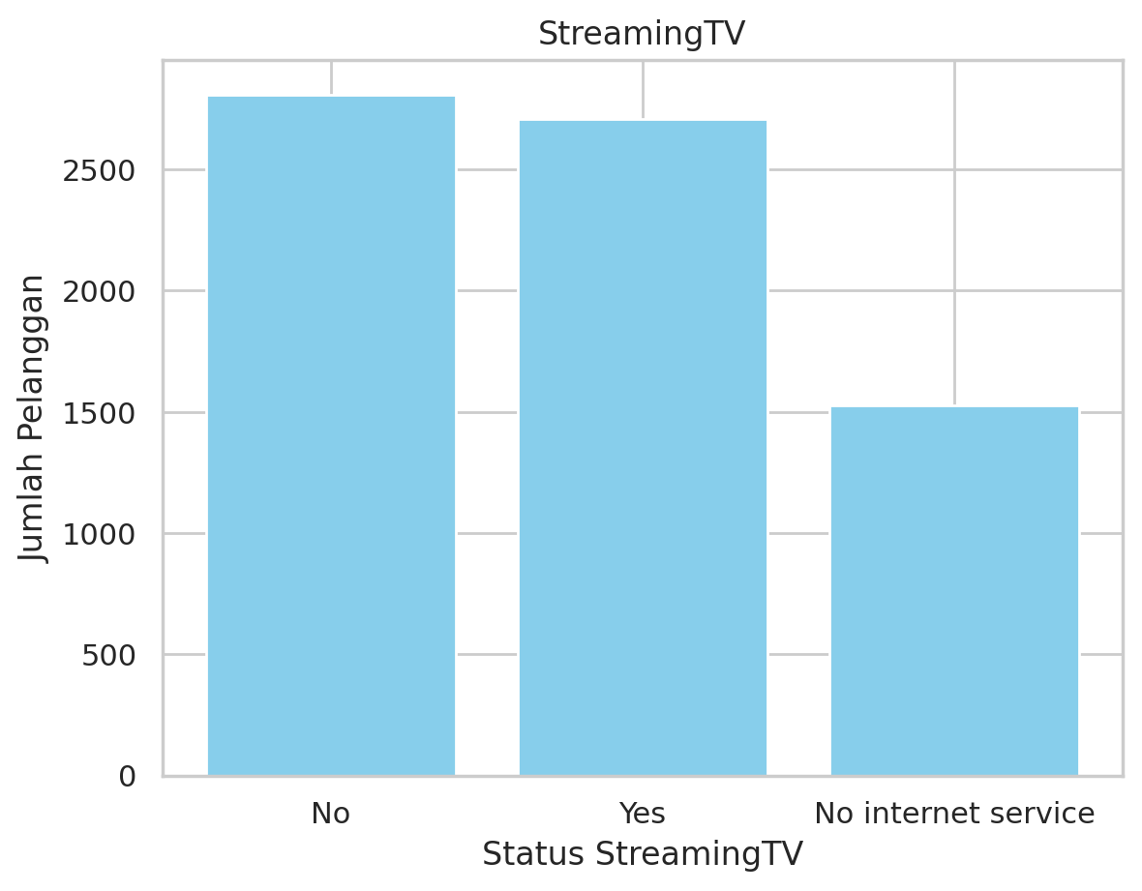
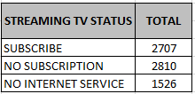
Exploratory Data Analysis
DISTRIBUTION OF SUBSCRIPTION STATUS ON STREAMING TV & STREAMING MOVIES

Slide 10
FEATURE SELECTION
Feature Selected :
Tenure
Monthly Charges
Contract
Online Security
Payment Method
Internet Service
Tech Support
Target :
Churn

Slide 11
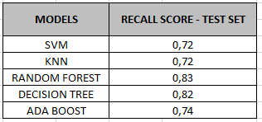


MODELING
AFTER HYPERPARAMETER TUNING
MODEL SELECTION
MODEL SELECTED
"In customer churn analysis, I prioritize using recall as the evaluation metric because it's more important to identify customers who might leave—even if some are misidentified—than to miss out on customers who will actually leave."

Slide 12
INSIGTHS
For Business :
There is potential for additional revenue from 2,810 individuals who have not yet subscribed to Streaming TV and 2,785 individuals who have not yet subscribed to Streaming Movies. Marketing/promotional strategies can be immediately developed to acquire these potential customers.
Electronic checks are the most commonly used payment method by customers for paying bills. To maintain the continuity of bill payments, the number of customers using auto-debit, whether through credit or debit, needs to be increased. The auto-debit feature automates bill payments, minimizing the risk of late payments.

Slide 13
INSIGTHS
For Business :
Customers who pay their bills monthly are the most numerous. To maintain customer loyalty, the options for one-year and two-year upfront payments should be enhanced, for example, by offering discounts to customers who pay their bills for one year or more in advance.

Slide 14
CONCLUSION
For Model :
Based on testing ,trial and error, it was found that the best model for completing this project is the Random Forest model that has undergone hyperparameter tuning. The Random Forest model used in this project was deemed to be overfitting because the recall value on the training data was higher than on the test data. The recall value for the training data was 0.99, while the recall value for the test data was 0.85.

Slide 15
THANK YOU AND CHEERS!

